Slide 1
Information Acquisition During Online Making
A MODEL-Based exploration using eye tracking data

Slide 2
Introduction
Aim: Study how consumers gather information while making decisions about products online and how these affect their decision making process. Finally this study can be used to try to optimize online information display formats by web retailers or comparision websites.
Types of display formats:
1)Horizontal format: Products presented in rows
2)Vertical format: Products presented in columns
Information acquisition processes
1)Attribute based: Information is obtained on a single attribute across multiple products
2)Product based: Information is obtained on a single product across multiple attributes

Slide 3
The use of two information acquisition processes over time is linked to different decision making stages and people switch between these processes during the decision making.
The presentation format has been shown to affect information acquisition:a horizontal format induces more product based processing and a vertical format more attribute based processing
Prior process tracing methods:Information is available through manual inspection such as mouse clicking and card turning.However comparision websites provide all attribute information of all products simultaneously on the display.
Eye movement data consist of eye fixations,which are brief moments that the eye is still and and information is being extracted.Saccades are rapid jumps of eye between fixations to redirect the line of sight to a new location.

Slide 4
Information acquisition processes and their switching are cognitive states that direct the eyes in a search for information on display.Eye movements reflect these states probabilistically.
To infer these probabilistically we use a probabilistic model known as Hierarchical Hidden Markov Model(HHMM) which consist of three layers: (1)Lower layer:-describes observed eye movements (2)Middle layer:-describes information acquisition processes(attribute and product based) (3)Upper layer:-describes how consumers switch between the processes based on higher order cognitive processes.
Research using traditional process tracing methods has shown that decision process is comprised of three stages:screening,evaluation and verification.
Screening is a serial inspection of mostly adjacent products;Evaluation is a comparision of limited set of remaining products;in Verification chosen product is was compared with others.
People switch between attribute and product based information acquisition process when the demands of the task changes.

Slide 5
Counter to some previous sampling models in which information elements are sampled independently information in this model is sampled depending on the current evaluation of alternatives.It allows the information sampled during a particular eye fixation to depend on information sampled till then.
Gaze cascade: During earlier stage of decision process one of the choices is chosen as preferred one and later attention moves towards this choice and becomes central in comparision and verification process. This pre decisional gaze bias on chosen product is called gaze cascade .
This model allows two or more higher order cognitive states to drive the switching between the processes.

Slide 6
A case study on a comparision website
Dell website was chosen for the study and participants were asked to choose a computer from those available on the website and during this process their eye movements were tracked.
After making their final choice they were asked to rate about the easiness of gathering information,deciding among the products and how confident they were about their final choice.
The saccades are distinguished into three types: Type1-Eye jumps between two products for same attribute; Type 2-Eye jumps between two attributes for same product; Type 3-Eye jumps from one attribute of one product to another attribute of another product.
From the study Type1 saccades are most prevalent in the middle part of the decision for vertical format and at the end for horizontal format.And Type2 saccades are most prevalent at the end of the decision for vertical format and middle part for horizontal format.
This indicates that the switching between attribute and product based eye movements is a nonstationary process across the decision time.
The study provides the evidence that product based processing is prevalent in horizontal format and attribute based processing is prevalent in vertical format.
It also provides the evidence of gaze cascade with highest percentage of last 2 fixations on chosen product.

Slide 7
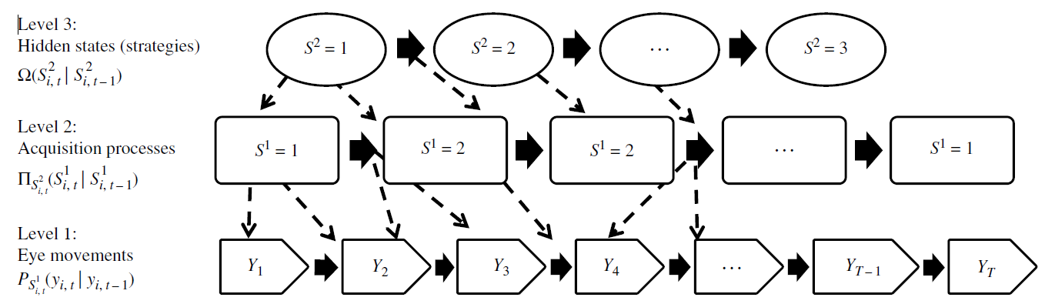
Hierarchical Hidden Markov Model

Slide 8
Notations:- i=1,2,……,I denote the participants and t=1,2,…..,T denote the fixations.
y_{i,t}=(a_{i,t},p_{i,t}) denote a particular cell in the display where a∈ {1,2,…..,A} are the attributes and
p∈{1,2,…….,P} are products at eye fixation t for participant i.
y_{i,t-1}=(a_{i,t-1},p_{i,t-1}) denotes cell at previous eye fixation t-1 for the same participant i.
The model is represented by three sets of transition probability matrices
1)an MxM matrix of transition probabilities between the states of the upper layer Ω(S²_{i,t}|S²_{i,t-1}).
2)M,NxN matrices of transition probabilities between the states of middle layer π_{S2i,t} (S¹_{i,t}|S¹_{i,t-1}) given the
states of upper layer(S²=1,2,…..,M)
3)The matrices of transition probabilities between the cells of the display P_{S1i,t}(y_{i,t}|y_{i,t-1}) given the states
S¹={1,2,….,N} of the middle layer.
Switching between the states in each layer follow a Markov process described by their respective transition probability matrices.

Slide 9
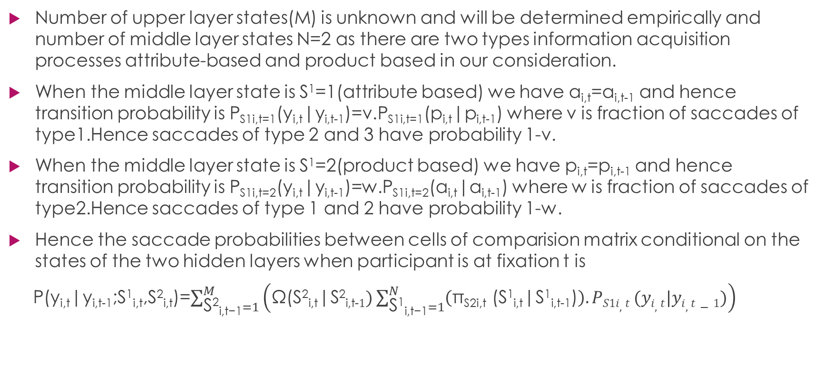
Number of upper layer states(M) is unknown and will be determined empirically and number of middle layer states N=2 as there are two types information acquisition processes attribute-based and product based in our consideration.
When the middle layer state is S¹=1(attribute based) we have a_{i,t}=a_{i,t-1} and hence transition probability is P_{S1i,t=1}(y_{i,t}|y_{i,t-1})=v.P_{S1i,t=1}(p_{i,t}|p_{i,t-1}) where v is fraction of saccades of type1.Hence saccades of type 2 and 3 have probability 1-v.
When the middle layer state is S¹=2(product based) we have p_{i,t}=p_{i,t-1} and hence transition probability is P_{S1i,t=2}(y_{i,t}|y_{i,t-1})=w.P_{S1i,t=2}(a_{i,t}|a_{i,t-1}) where w is fraction of saccades of type2.Hence saccades of type 1 and 2 have probability 1-w.
Hence the saccade probabilities between cells of comparision matrix conditional on the states of the two hidden layers when participant is at fixation t is
P(y_{i,t}|y_{i,t-1};S¹_{i,t},S²_{i,t})=$\sum_{\text{S}\text{2}\text{i}\text{,}\text{t}\text{−1}=1}^{M}{\left(\text{Ω}\text{(}\text{S}\text{2}\text{i}\text{,}\text{t}\text{|}\text{S}\text{2}\text{i}\text{,}\text{t}\text{−}1)\sum_{\text{S}\text{1}\text{i}\text{,}\text{t}\text{−1}=1}^{N}{\left(\text{π}\text{S}\text{2}\text{i}\text{,}\text{t}\text{ (}\text{S}\text{1}\text{i}\text{,}\text{t}\text{|}\text{S}\text{1}\text{i}\text{,}\text{t}\text{−1)}\right).PS1i,t}(yi,t|yi,t−1)\right)}$

Slide 10
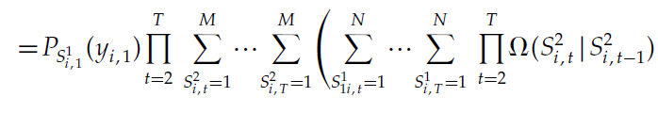
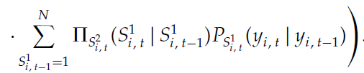


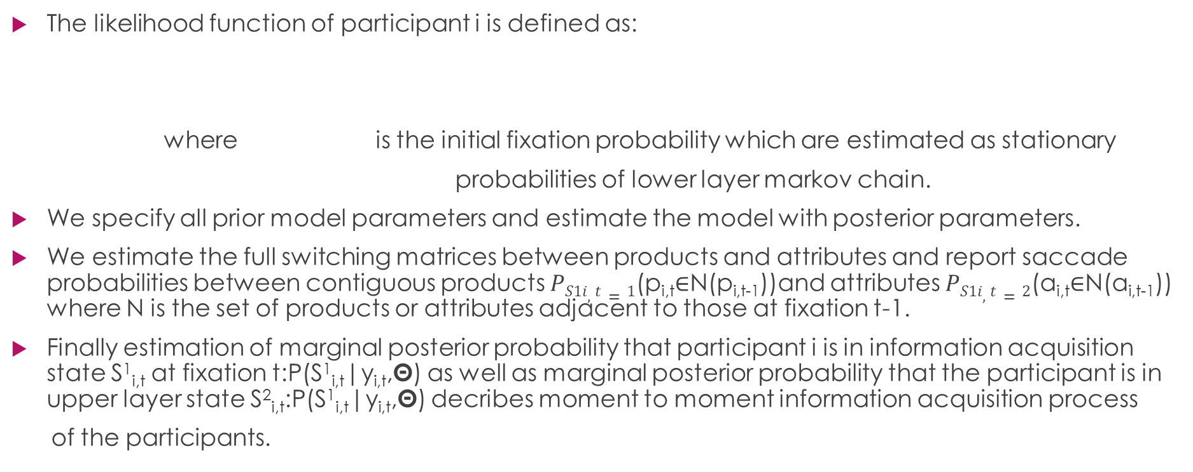
The likelihood function of participant i is defined as:
where is the initial fixation probability which are estimated as stationary
probabilities of lower layer markov chain.
We specify all prior model parameters and estimate the model with posterior parameters.
We estimate the full switching matrices between products and attributes and report saccade probabilities between contiguous products $PS1i,t=1$(p_{i,t}∈N(p_{i,t-1}))and attributes $PS1i,t=2$(a_{i,t}∈N(a_{i,t-1})) where N is the set of products or attributes adjacent to those at fixation t-1.
Finally estimation of marginal posterior probability that participant i is in information acquisition state S¹_{i,t} at fixation t:P(S¹_{i,t}|y_{i,t},Θ) as well as marginal posterior probability that the participant is in upper layer state S²_{i,t}:P(S¹_{i,t}|y_{i,t},Θ) decribes moment to moment information acquisition process
of the participants.

Slide 11
Results
The proposed model was compared to various other models using log marginal density(LMD).Higher LMD means higher performance of the model.
Models with just two layers and those models in which upper layer is a mixture of HMMs have higher LMDs than HMMMs.
Among HMMMs the LMDs values are observed to increase with increasing number of upper layer hidden states but the change is very much negligible after 3 hidden states.
Hence the model with 3 upper layer states is used for the research.
Parameter estimates for lower layer show that participants are much more consistent in moving their eyes along the same attribute, regardless of whether the products are presented in rows or columns.
It is also observed that horizontal eye movement(left to right) is dominated by other movements.
This may be due to rapid decline in the resolution of the retina in the vertical direction than horizontal.

Slide 12
Participants are much more prone to compare information from adjacent attributes than from adjacent products.They are even more likely to do so in vertical format.
From the parameter estimates for middle layer and upper layer it is seen that participants are more likely to start(earlier stage of decision process) with product based acquisition,especially in horizontal format.
On average,participants spend about 45% of the time in attribute based state and 55% in product based and switch on average about 46 times between these states.
The upper layer parameters S²=1 induces state dependence as the probabilities are higher in case of sticking to attribute based or product based state.S²=2 induces switching to or staying in attribute based acquisition state.S²=3 induces switching to or staying in product based acquisition state.
It is evident that product based acquisition is dominant at the beginning and end of decision process and in the middle attribute based acquisition is dominant.

Slide 13
Probability of switching to another acquisition process increases as more information has been acquired through that process.
Upper layer states may depict the decision goals over time.
It is seen that 1/5th of the attributes are not at all inspected during decision process showing selective attention to products and attributes.
Consideration set(products being considered for inspection at a particular time) changes over time.Options are removed or reconsidered for inspection.
In product based acquisition state,attributes enter the decision process sequentially(some are not all considered)
A particular product gets more number of cumulative fixations at the end(presence of gaze cascade)

Slide 14
It is reasonable to assume that the upper layer states reflects the effects of customer’s moment to moment to moment trade off between various decision goals like accuracy,effort and verification.
There is strong tendency of eye movements from left to right(horizontal direction) irrespective of the display format.
This study may influence the website design factors like sorting the products to gain relative importance, grouping similar elements close together,eliminating unnecessary information and highlighting important information.

Slide 15
THE END

